Slide 1

ResumAI
AI Resume Analyzer
Team 4 - Iteration 3 Presentation
Team Members: Amruth, Jaindra, Faizan, Tushar, Shubh, Hemant

Slide 2
Requirement Analysis
- Functional requirements prioritized:
- Resume Analysis
- Recruiter and applicant dashboards
- User stories tracked via Pivotal Tracker.
- Metrics:
- 80% of planned user stories completed in Iteration 3.
- 21 user stories
- 16 tasks
- 51 sub tasks
- 2 bugs

Slide 3
Design
- Software Architecture: Client-server design.
- Frontend: React with Redux and Material UI.
- Backend: Fastify framework with PostgreSQL database.
- Tools: Redis for caching, AWS SQS for event streaming.
- Design Patterns:
- Singleton for database connections.
- Middleware for API authentication and validation.
- Promise for async API/database calls.
- Key Algorithms: Resume matching and ranking based on job description analysis.

Slide 4
Implementation
- Integrated Features:
- Resume scoring and detailed analytics.
- Recruiter feedback system.
- Database Enhancements: Optimized schema for ResumeMatch and Job Listings tables.
- Tools:
- Fastify for backend services.
- PostgreSQL and Redis for storage and caching.
- AWS SQS for real-time notifications.

Slide 5





UI Developments
Notes:
Vite
Jest

Slide 6
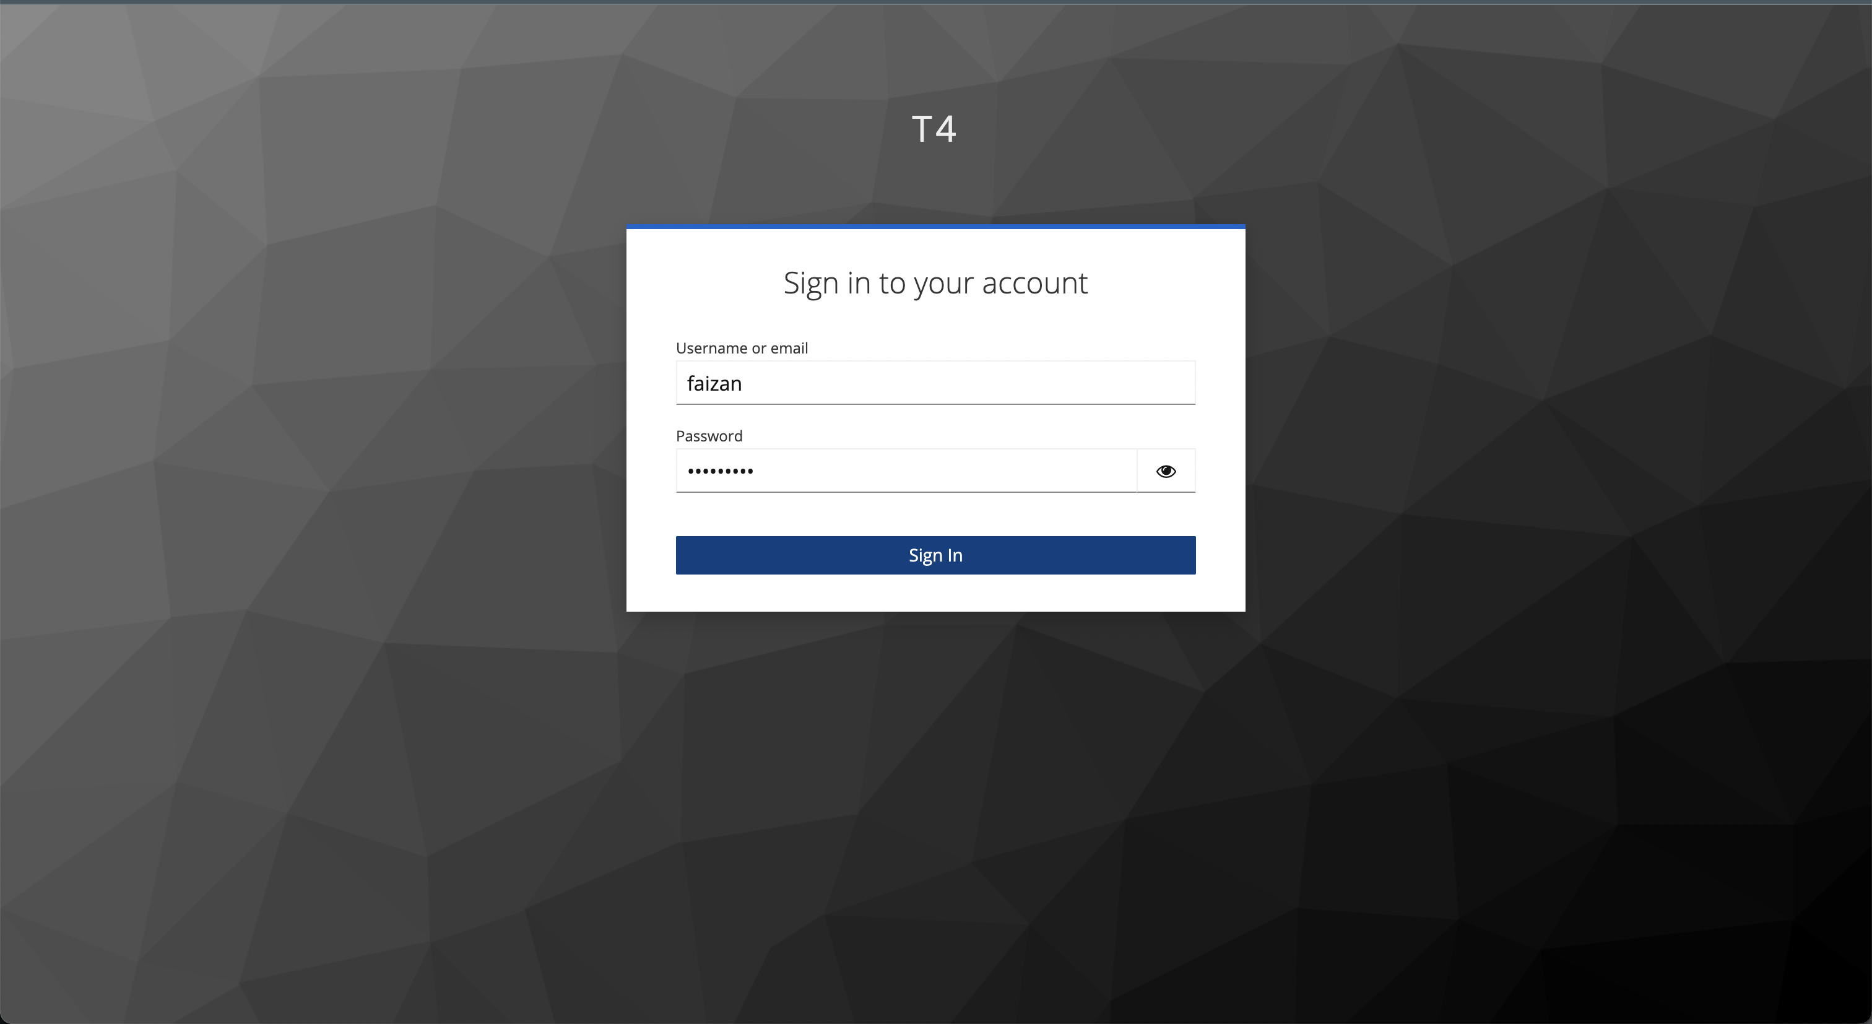
UI Developments
Keycloak auth

Slide 7
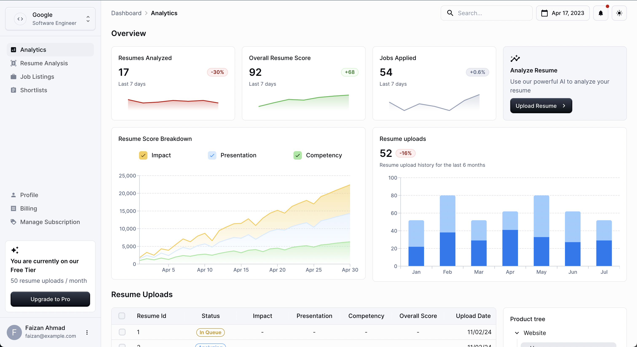
UI Developments
Main Dashboard - Light

Slide 8
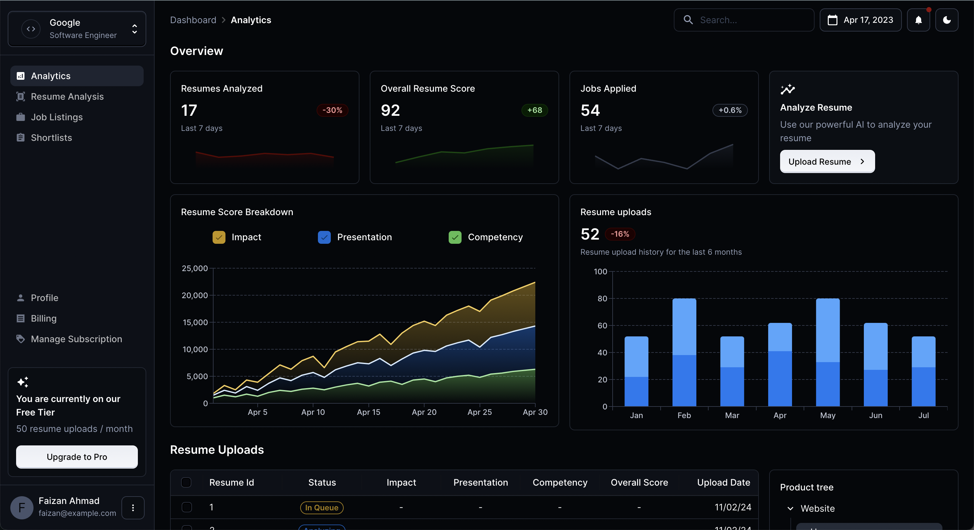
UI
Main Dashboard - Dark

Slide 9
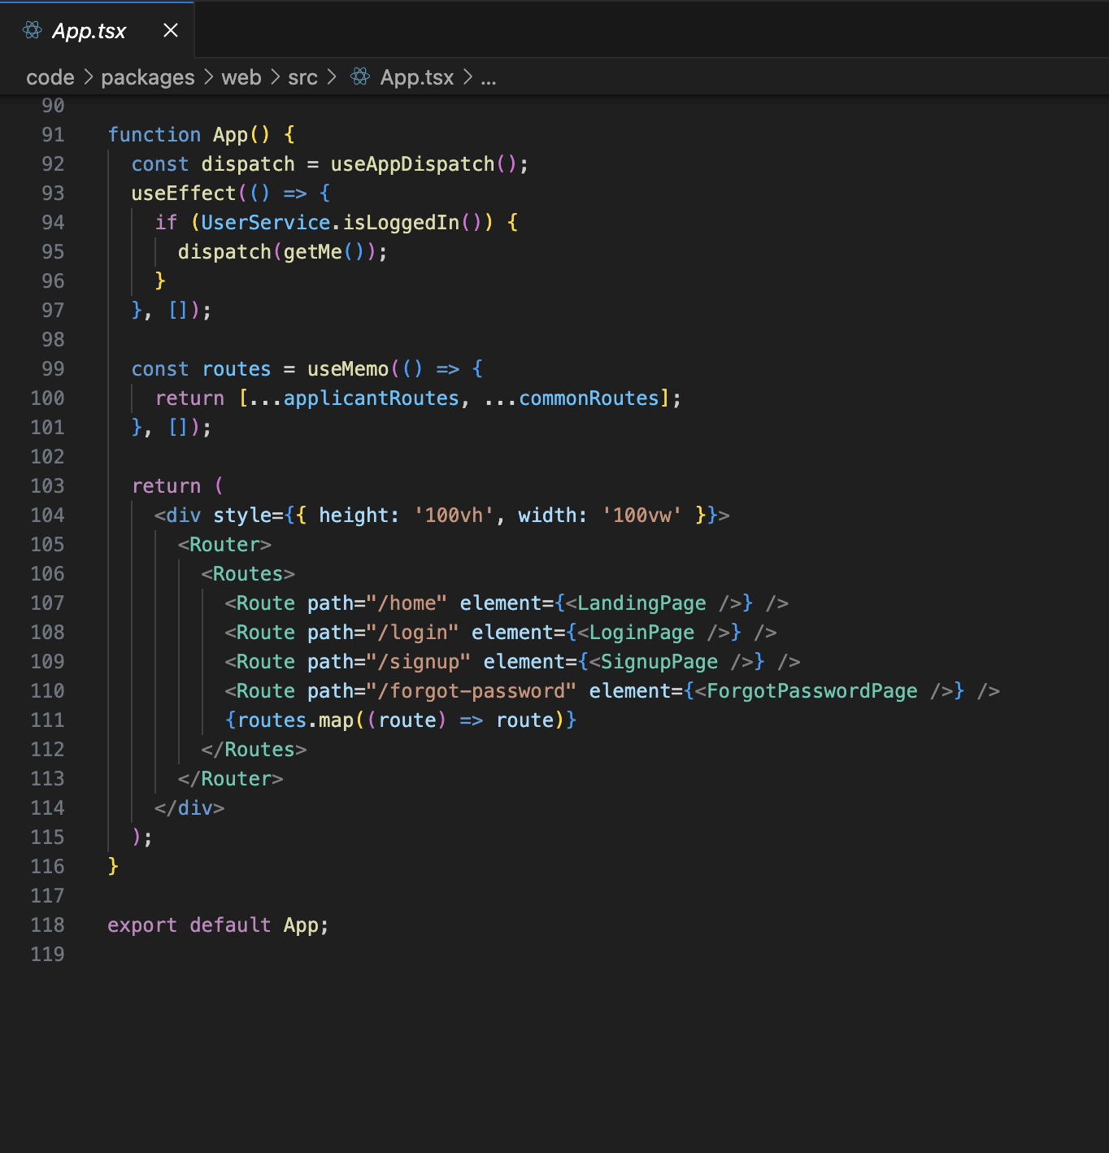
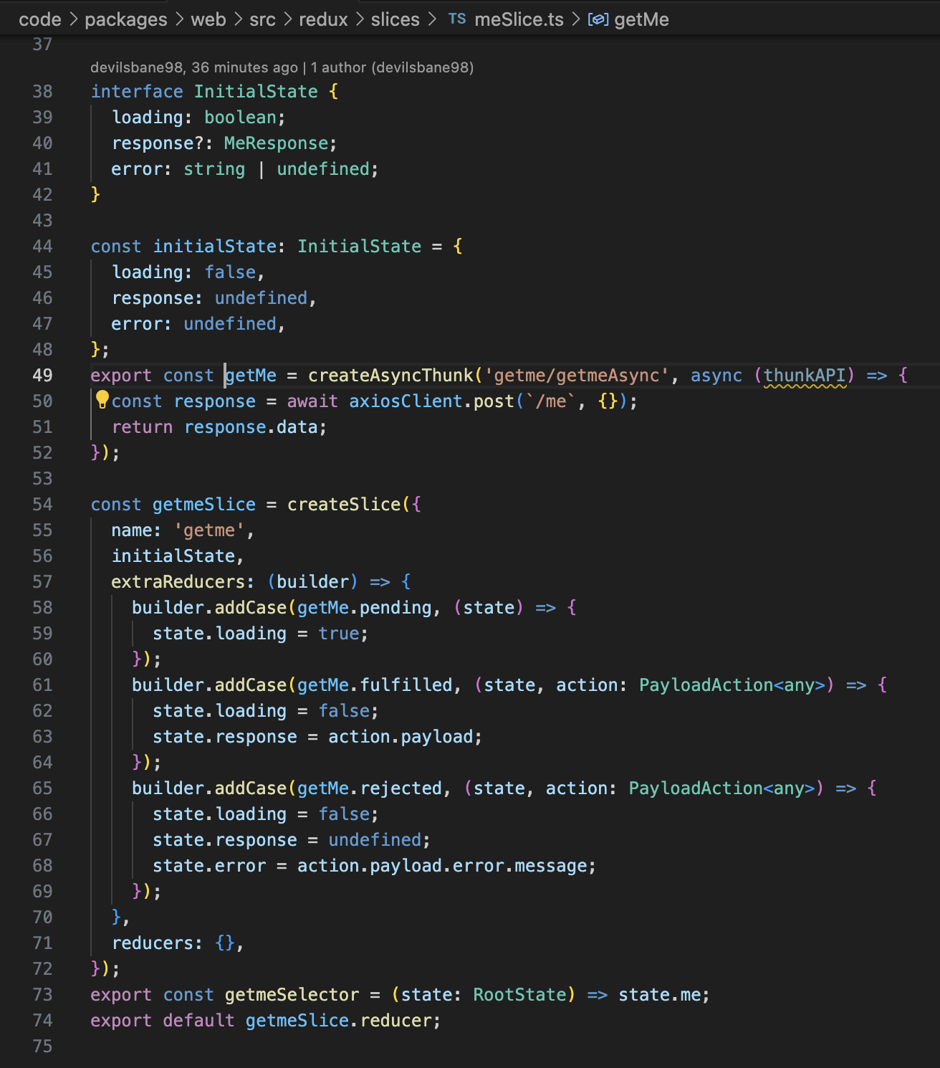
UI

Slide 10
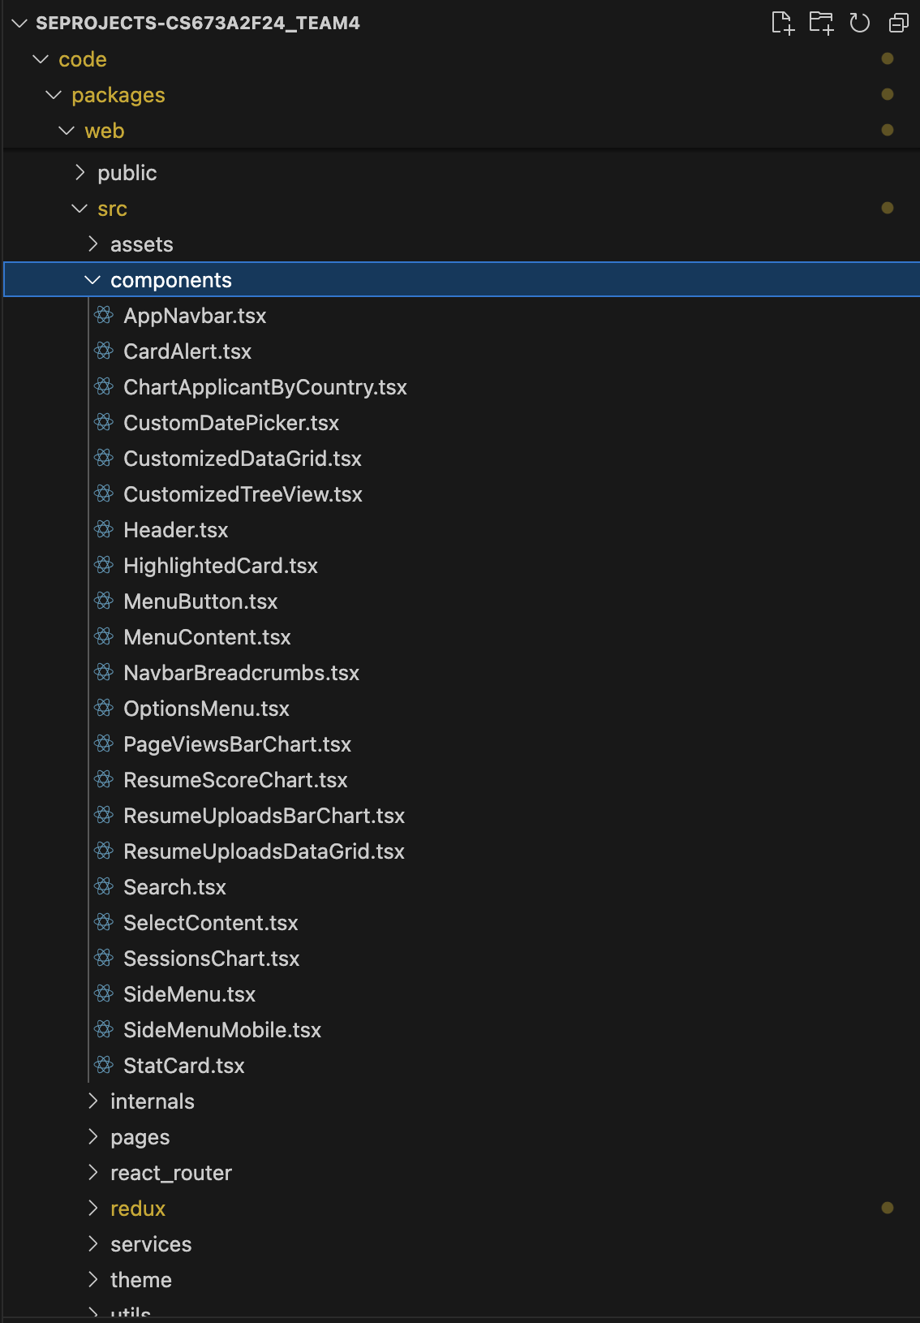
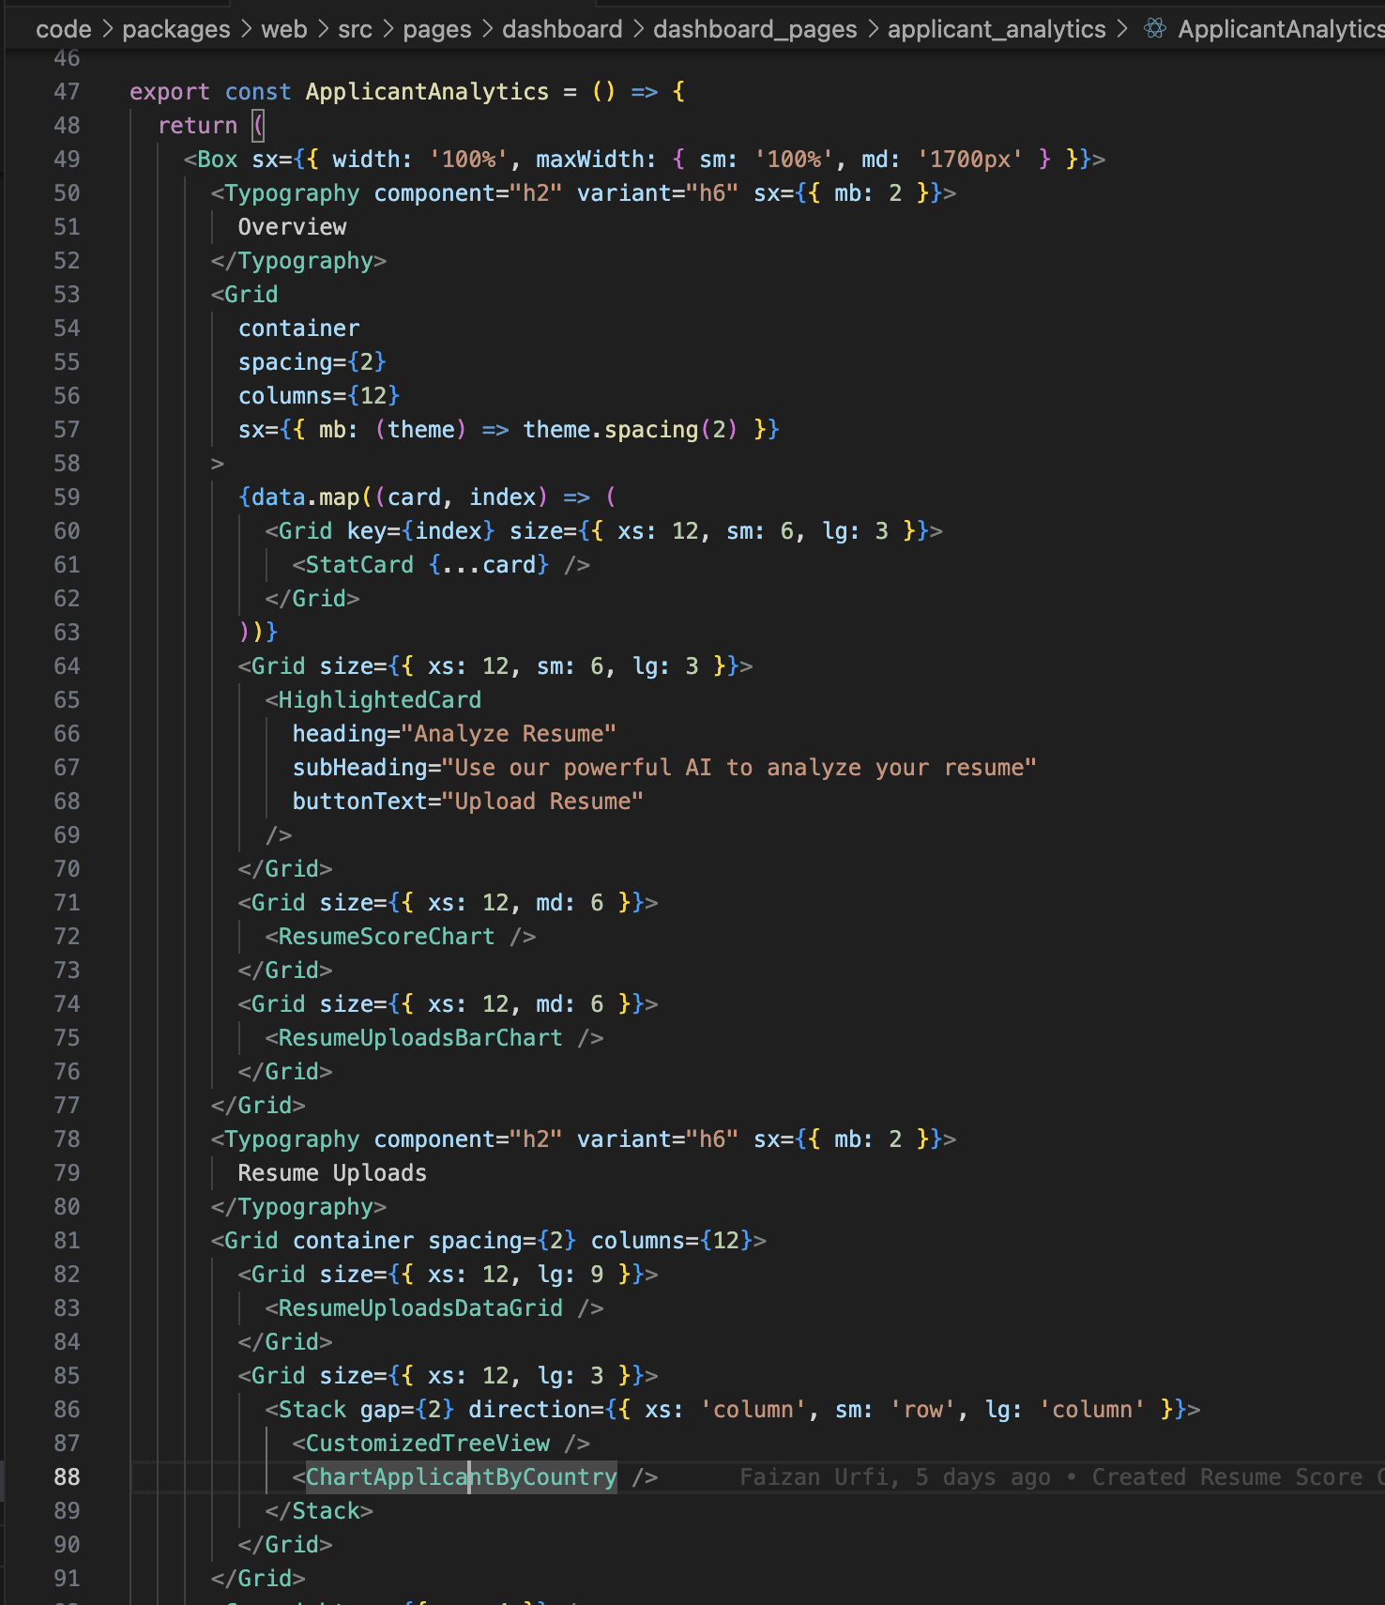
UI

Slide 11
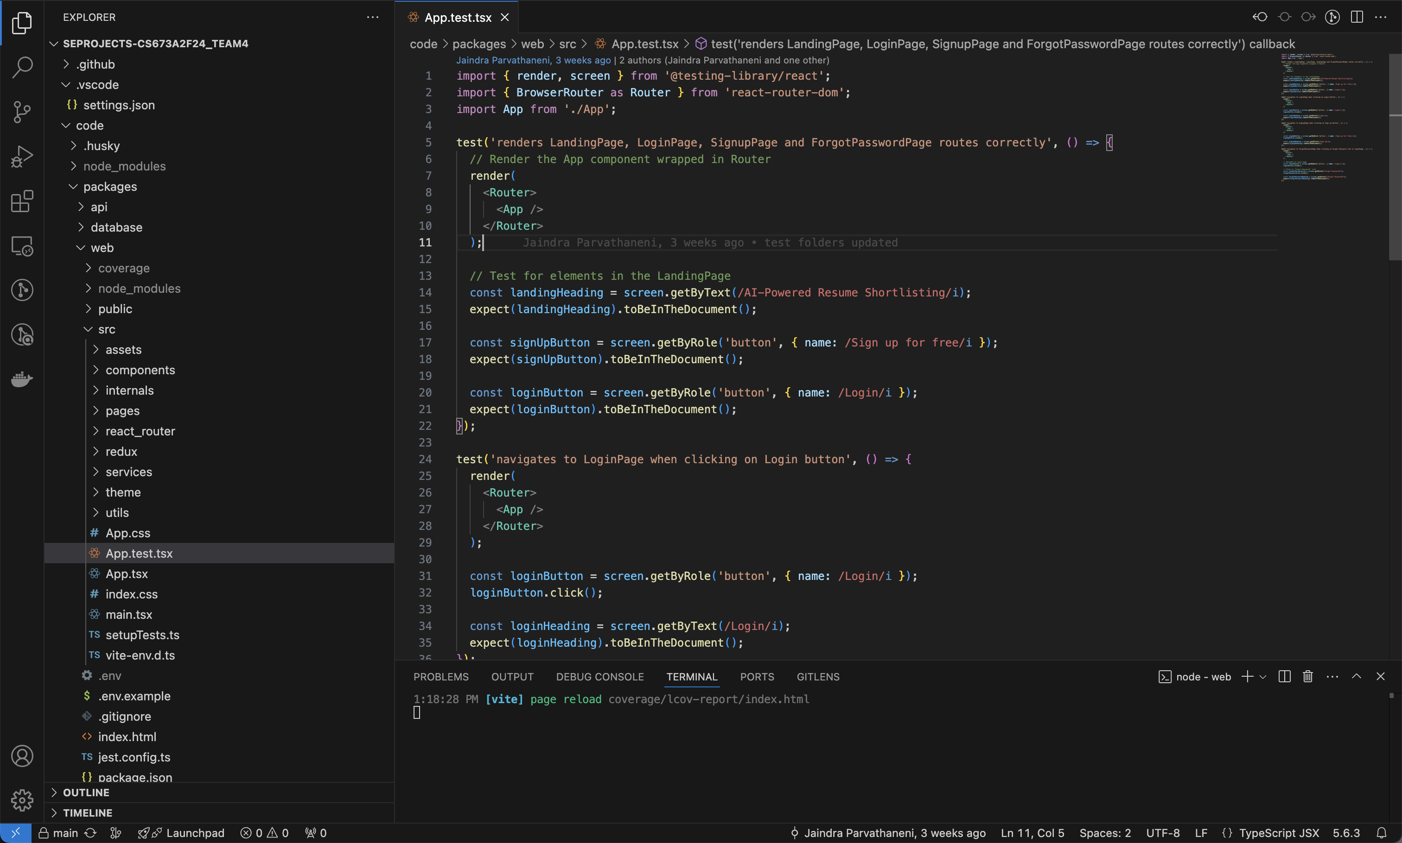
Frontend Testing Junit

Slide 12
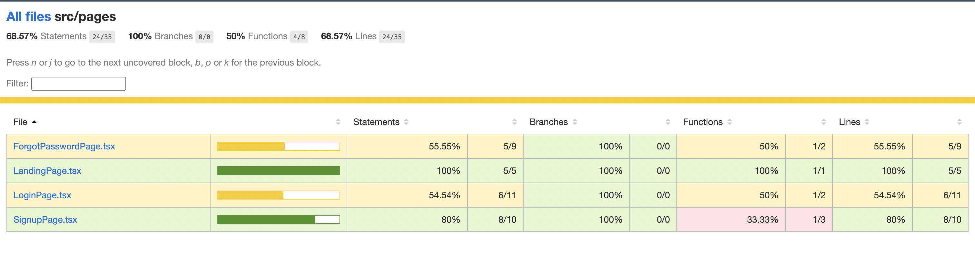
Frontend Testing Coverage

Slide 13






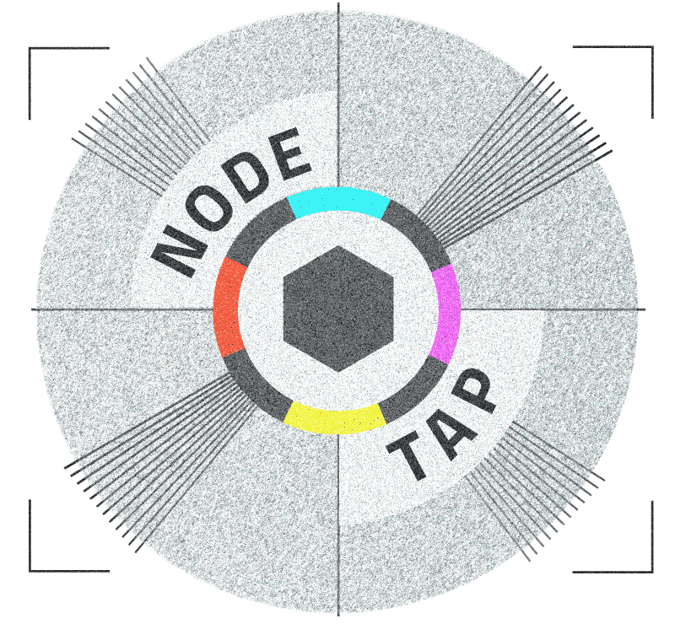

Backend

Slide 14
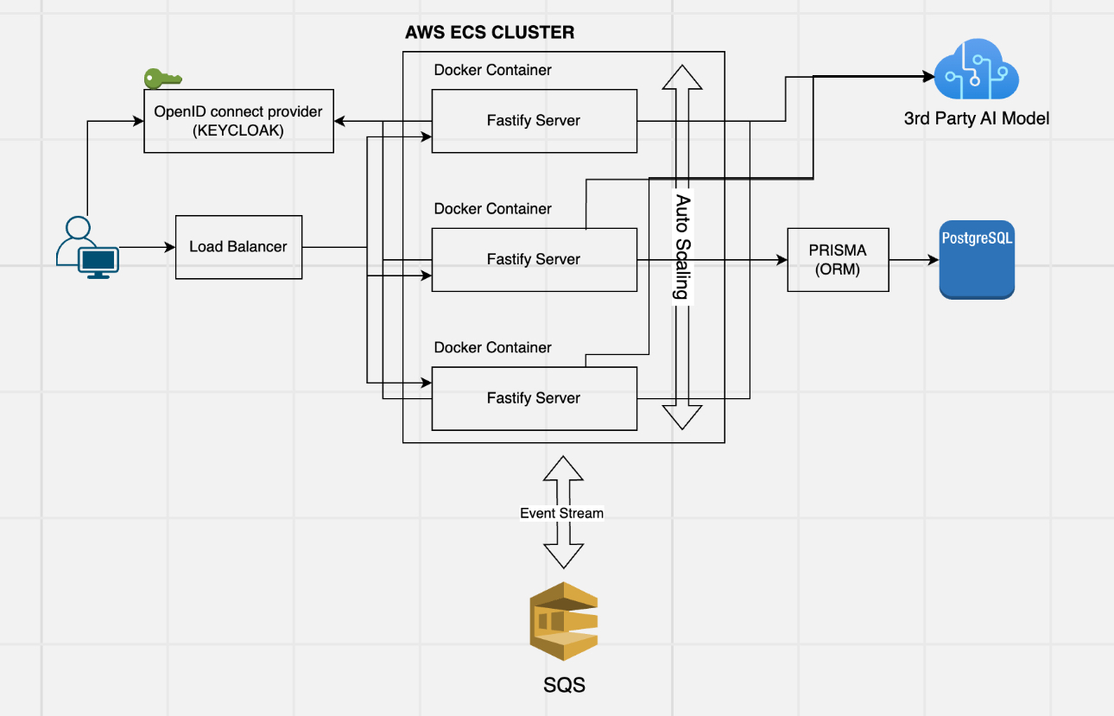

Slide 15
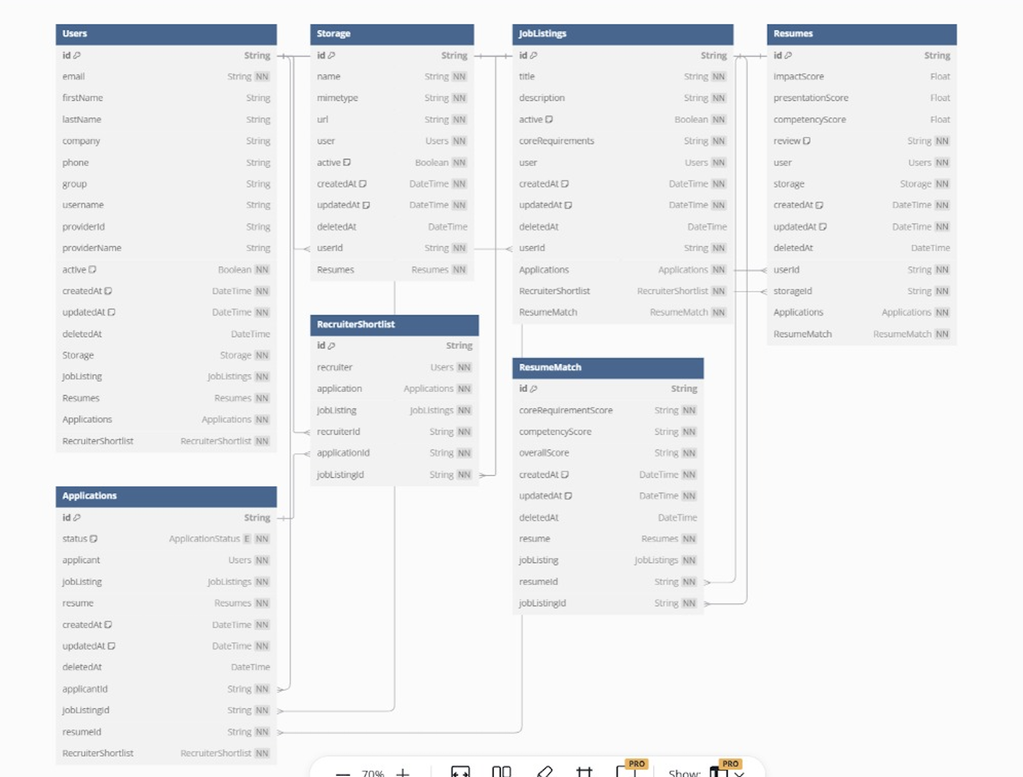

Slide 16
Testing
- Types of Testing:
- Unit tests for core components with Jest.
- Integration tests for frontend-backend compatibility.
- Backend API tests using node-tap to ensure appropriate processing

Slide 17
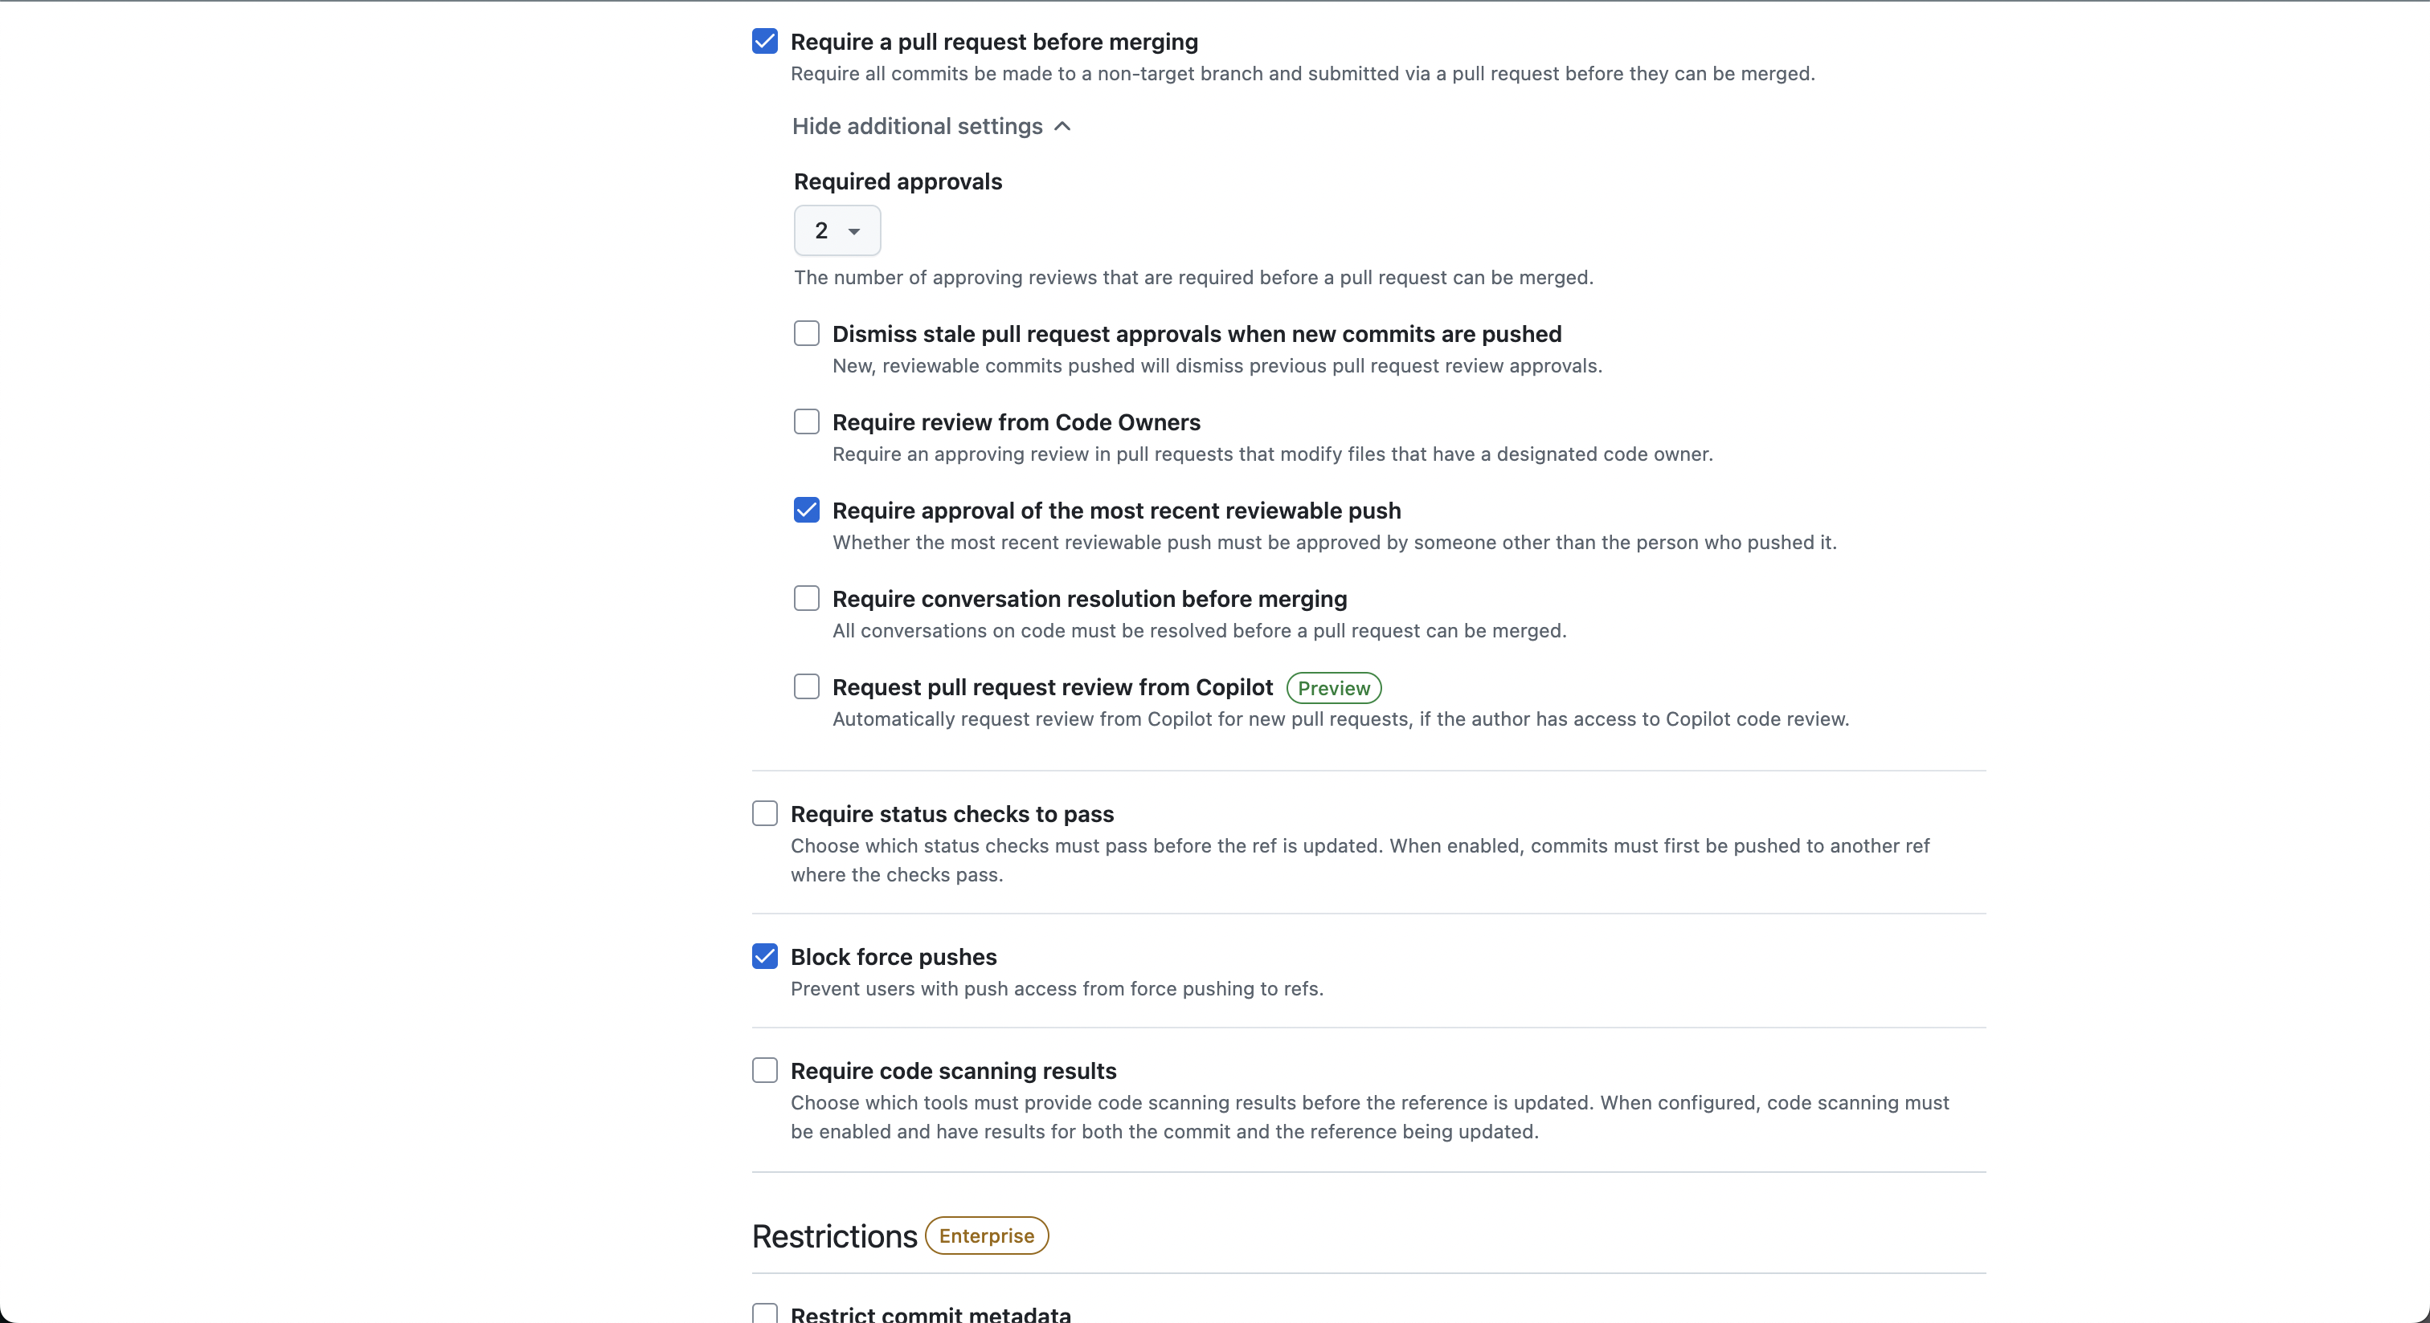
Code Reviews config

Slide 18
Security
- Techniques:
- Keycloak for identity and access management.
- JWT tokens for secure API sessions.
- Prisma ORM for intermediate database security.
- Additional Measures:
- Private AWS networks with VPN.
- Proxy setup for enhanced API protection.

Slide 19
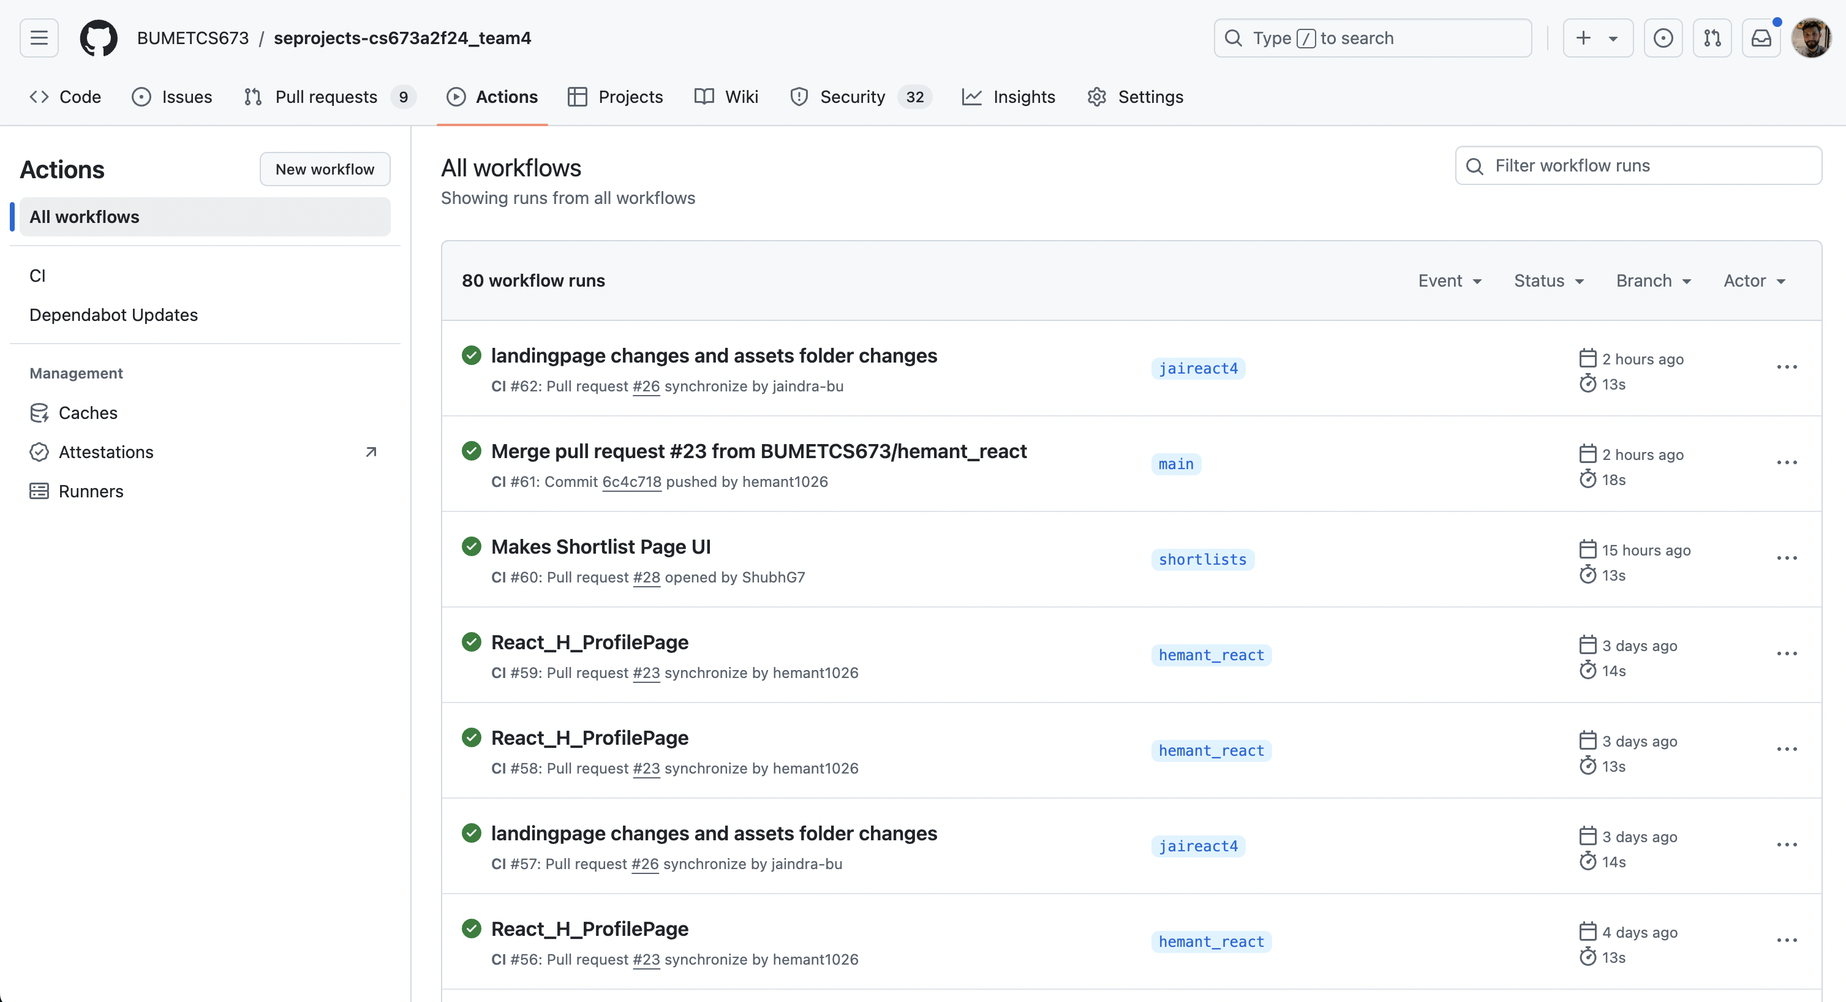
Github Actions

Slide 20
Configuration and Deployment
- CI/CD Pipeline: GitHub Actions with environment-specific deployments.
- Deployment Details:
- Dockerized services for backend and frontend
- Containers deployed via AWS ECS with a reverse proxy using nginx
- Added auto-scaling for horizontally scaling container deployment
- Database Deployed via AWS RDS

Slide 21
Iteration Evolution
Setup: Established Git workflows, finalized tech stack, and set up the development environment.
Design & Development: Built core features using React, Figma, and TypeScript, and implemented Jest for testing.
Integration & Testing: Integrated frontend with backend, resolved environment issues, and conducted thorough testing.
Finalization: Completed features, major bug fixes, prepared documentation, and delivered project presentations.

Slide 22
Achievements
Developed a full-stack application with seamless integration and robust testing.
Created key features like recruiter shortlist, payment pages, and dashboards.
Automated workflows with Prettier, ESLint, and Jest, ensuring code quality.
Fostered strong team collaboration and skill development in React, TypeScript, and Figma.
Generated successful resume analysis(individually as well as against a job description) via Claude through Anthropic

Slide 23
Challenges
Environment setup issues (e.g., port conflicts, Docker configurations).
Integration difficulties between frontend and backend.
Managing time while learning new tools and debugging errors.
Access control for different pages between recruiter and user pages due to redux context switching lag
Integrating AI. Tested different AI models and struggled with providing a pdf and prompt together
Using the correct descriptive prompt to AI to get desired results with accuracy based on custom metrics

Slide 24
Lessons Learned
Clear communication and task delegation are crucial for efficiency.
Early research and setup reduce later development hurdles and agile methodologies.
Collaboration and adaptability help overcome technical challenges.
Automated testing and workflows ensure quality and save time.

Slide 25
Team Contributions
Team Member | Role | Individual Contribution
Hemant Krishnakumar | Team Lead | Coordinated team efforts, managed sprints, and prepared project documentation. Created the Figma designs for the application. Implemented React components, integrated TypeScript, and refined Figma designs. Set up and maintained the full stack environment, resolving technical issues. Reviewed pull requests and collaborated on finalizing pages with Jaindra. Created test cases, handled CSS updates, for multiple pages.
Tushar Kendre | Requirements Lead | Designed databases, implemented CRUD APIs, and JWT authentication. Set up SSO, Redux slices, and API integration with search functionality. Finalized tech stacks and resolved environment and Keycloak issues. Standardized workflows and development environment. Created backend APIs for additional CRUD operations Set up node-tap for backend testing with mocks for SSO service Created pages for Create, apply and shortlist resumes along with API integration Added access control to pages accessible by recruiters and applicants Integrated APIs into Profile, Job Listings, Job Details pages
Faizan Ahmed | Design and Implementation Lead | Finalized database designs, UML diagrams, and integrated Redux reducers. Developed the dashboard UI using Material UI, including themes, charts, and routing. Configured Prettier, ESLint, Git hooks, and CI/CD pipelines. Reviewed PRs, tested code, and guided the team on JEST and Redux setups. Researched tech stacks and system designs, implementing key tools like JIRA and Redux. Created the Main React Dashboard with all the shared components under components folder Integrated Anthropic AI model to scan and review resume Cerated UI to show resume analysis
Jaindra Parvathineni | Integration Lead | Set up Git workflows, branching strategies, and Docker environments. Collaborated on Figma-based designs Developed and integrated React components for landing, login, and job listings pages. Reviewed pull requests and collaborated on finalizing pages with Hemant. Created test cases, handled CSS updates, and resolved environment and port issues. Delivered iteration presentations and contributed to project documentation. Wrote unit tests for front-end/
Amruth Reddy | Security Lead | Learned and implemented Git, Django, React, and Figma for project development. Refined project requirements, contributed to MVP features, and presented deliverables. Integrated React components with Figma designs and supported front-end/back-end alignment. Led team meetings, managed risk documentation, and ensured sprint timelines were met. Contributed to Git setup, CRUD implementation, and explored Prisma and Redis. Reviewed PRs, tested code , resolved technical issues
Shubh Gupta | Testing Lead | Developed and tested components like the Payment page and Recruiter Shortlists page using React, Material UI, and Jest. Setup Deletion and Updation in components across the application, Contributed in functionality in Profile Page, Job Listings page and Applications Shortlists component, etc. Handled Group Based routing for “recruiter” and “user” groups. Set up the development environment with Docker, Redis, and Prisma, and configured Prettier and ESLint for automation. Researched and implemented testing methods, creating test cases for various pages. Collaborated on Figma-based designs, UML diagrams, and project presentations.

Slide 26
Demo

